Slide 1
PHASE ONE PROJECT Moringa School-Data Science
Margaret Sarah Wanjiru Njoroge

Slide 2
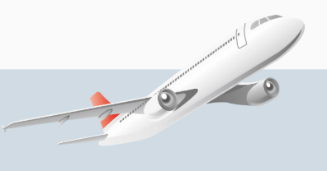
Title: Aviation Accident Analysis
Year Range: 1962–2023

Slide 3
OVERVIEW
Main objective:
Aims to deliver data-driven insights that would provide insights in efforts to improve air safely
Specific objectives:
To show the most common causes of aviation accidents
To show how accident rates vary by aircraft type and location
To understand the role of weather in aviation accident
Data Source:
A csv file from National Transportation Safety Board (NTSB) with accident reports ranging 1962-2023
Business Understanding:
Purpose of this analysis is based on understanding aviation accident trends to improve safety and operations.

Slide 4
DATA UNDERSTANDING
Data Composition:
Accident date, location, aircraft type, fatalities and contributing factors
Missing values handled using imputation techniques.
Comments on the data
As part of data cleaning, addressed duplicates and handled missing values
Derived insights from temporal trends.

Slide 5
DATA ANALYSIS
Some of the analysis I have managed to analyse and make visualizations included:
Accidents trend over time
Severity of accidents
Phase of flights where most accidents take place
Fatal and non fatal accidents by weather
Number of accidents as influenced by weather
Categorization of accidents based on purpose of flights
The number of accidents for every make of aircrafts

Slide 6
Recommendation
The makes recording highest number of accidents be assessed to rule out technical malfunction and so that safety measures on the crafts can be checked and improved
Avoid flying in bad weather conditions
The data should have included fatalities caused by pilots; maybe categorized in terms of pilot skill level, level of rest before the flight and number of trips in the same route. This would make the accident analysis more comprehensive
It was not possible to tell the most common cause of accident using this dataset

Slide 7
Next Step:
Would be great to do a predictive model for accident risk assessments and monitoring
Be able to get real time feedback and insights on the dashboard

Slide 8


MARGARET SARAH WANJIRU NJOROGE
LINKEDIN: SARAH NJOROGE

